Slide 1
New Hacks
App Development: Assignment Due(AD)
Team: JHYC Code

Slide 2
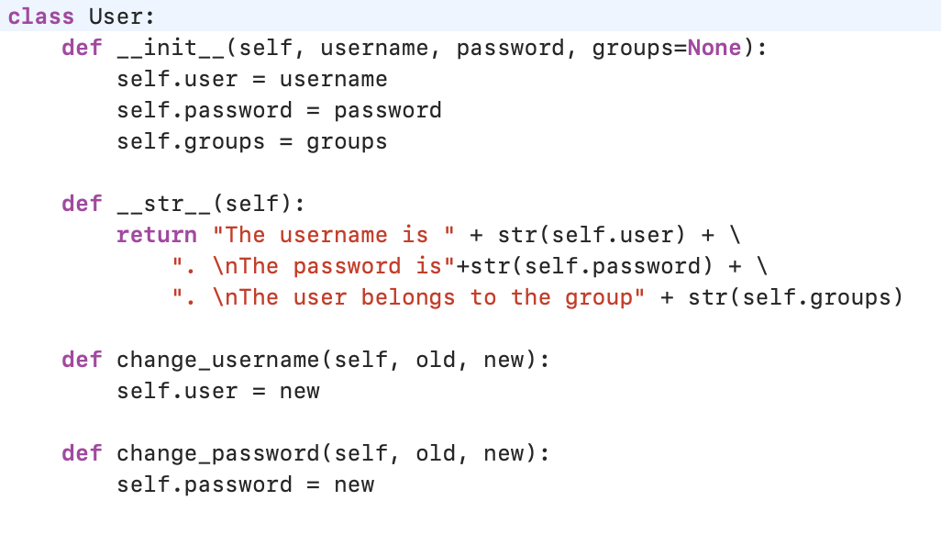
Class User
Class user asks user’s basic information including their username, password and groups.

Slide 3
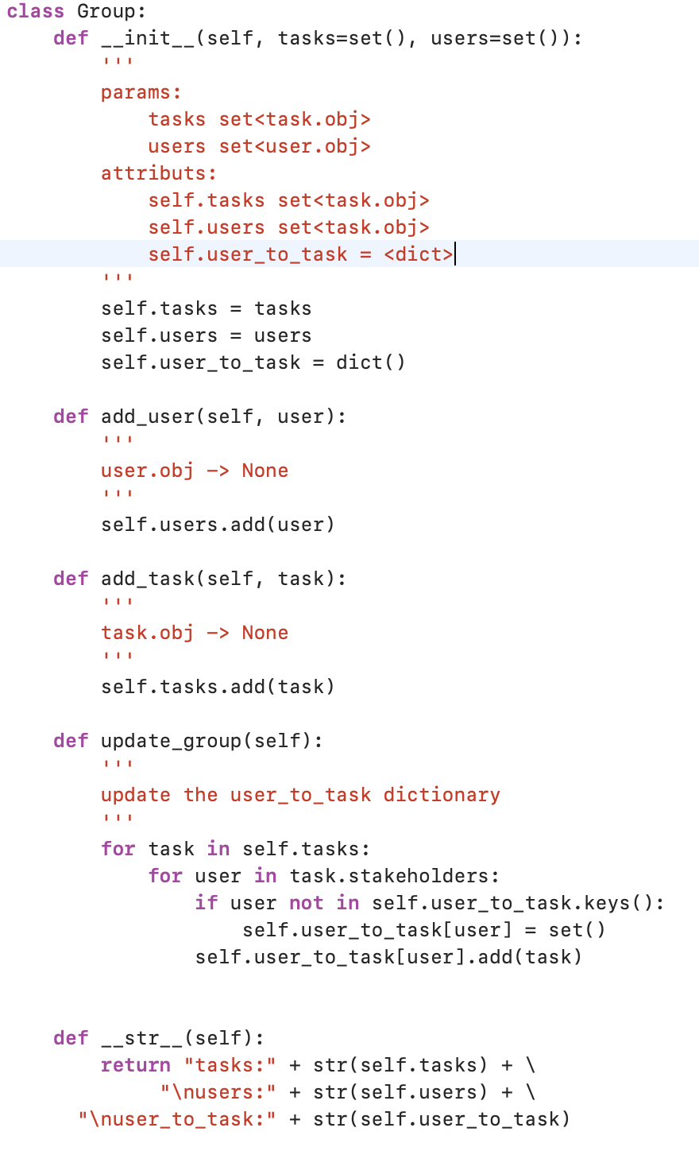
Class Group
This class will create a group and add tasks and new user in the group

Slide 4
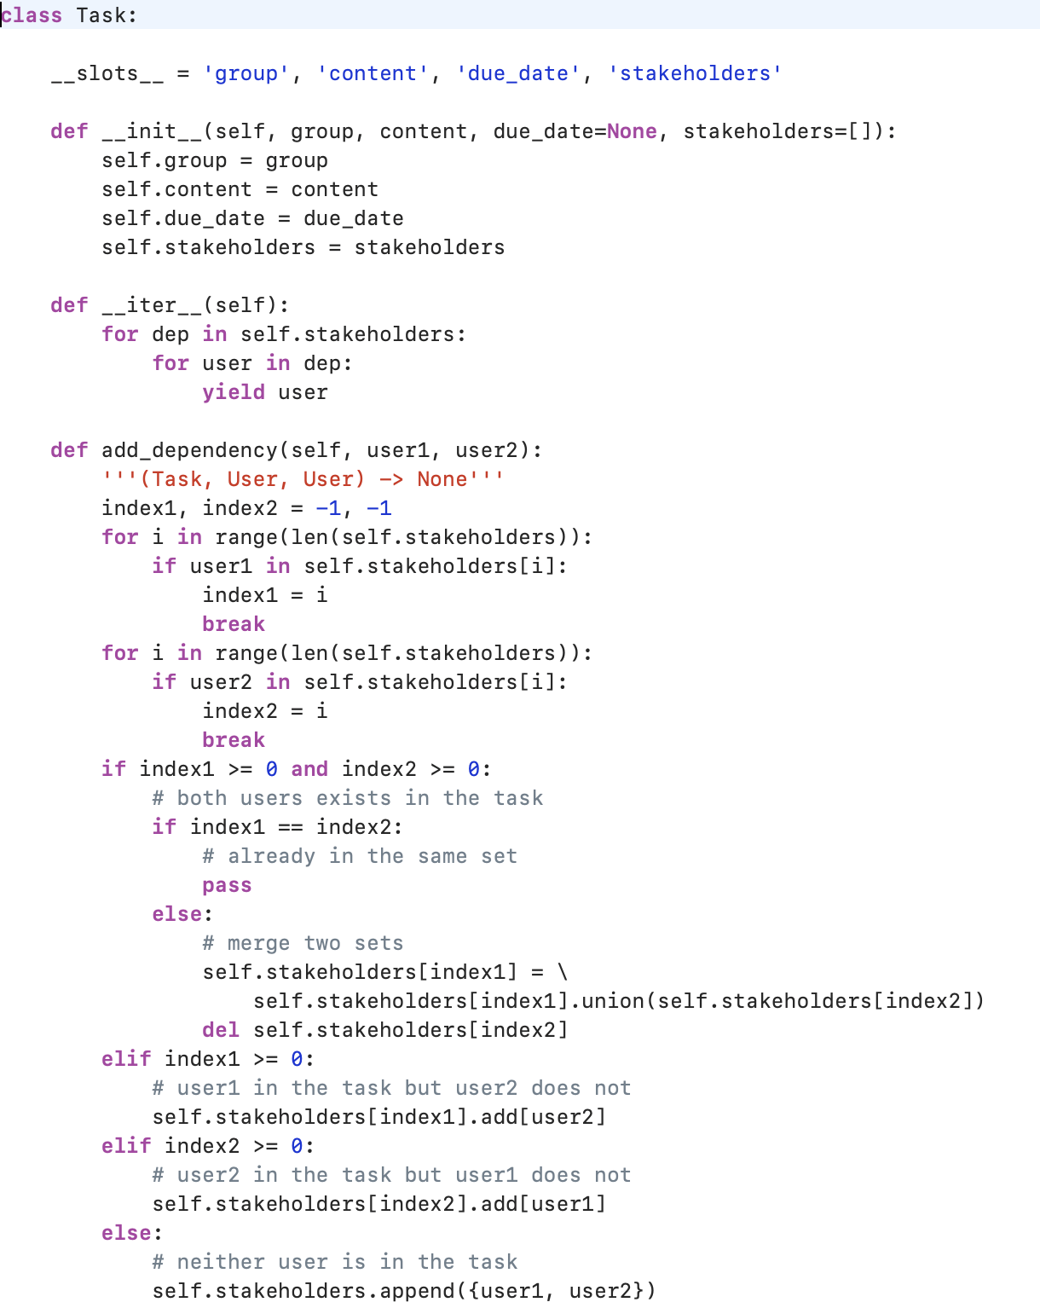
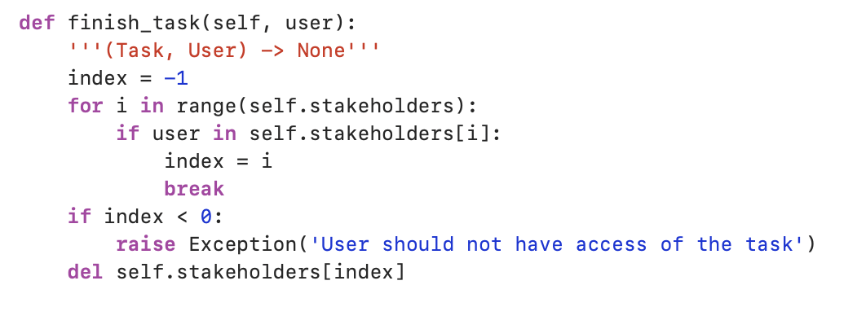
Class Task
This class will initiate the task class and add dependency for each of the users. The dependency means that if one user is in the same group.

Slide 5
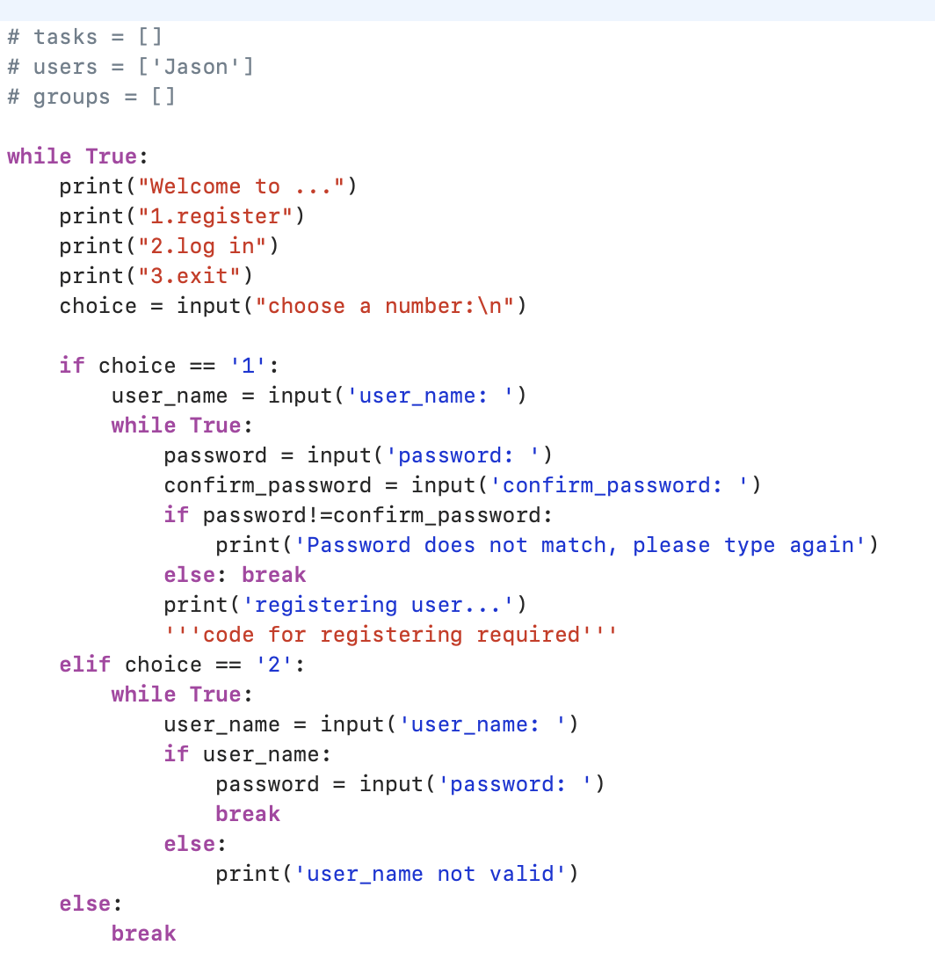
Interface Setup
Users will be asked to input their username and password and this step will check if they are already in the system or not.

Slide 6
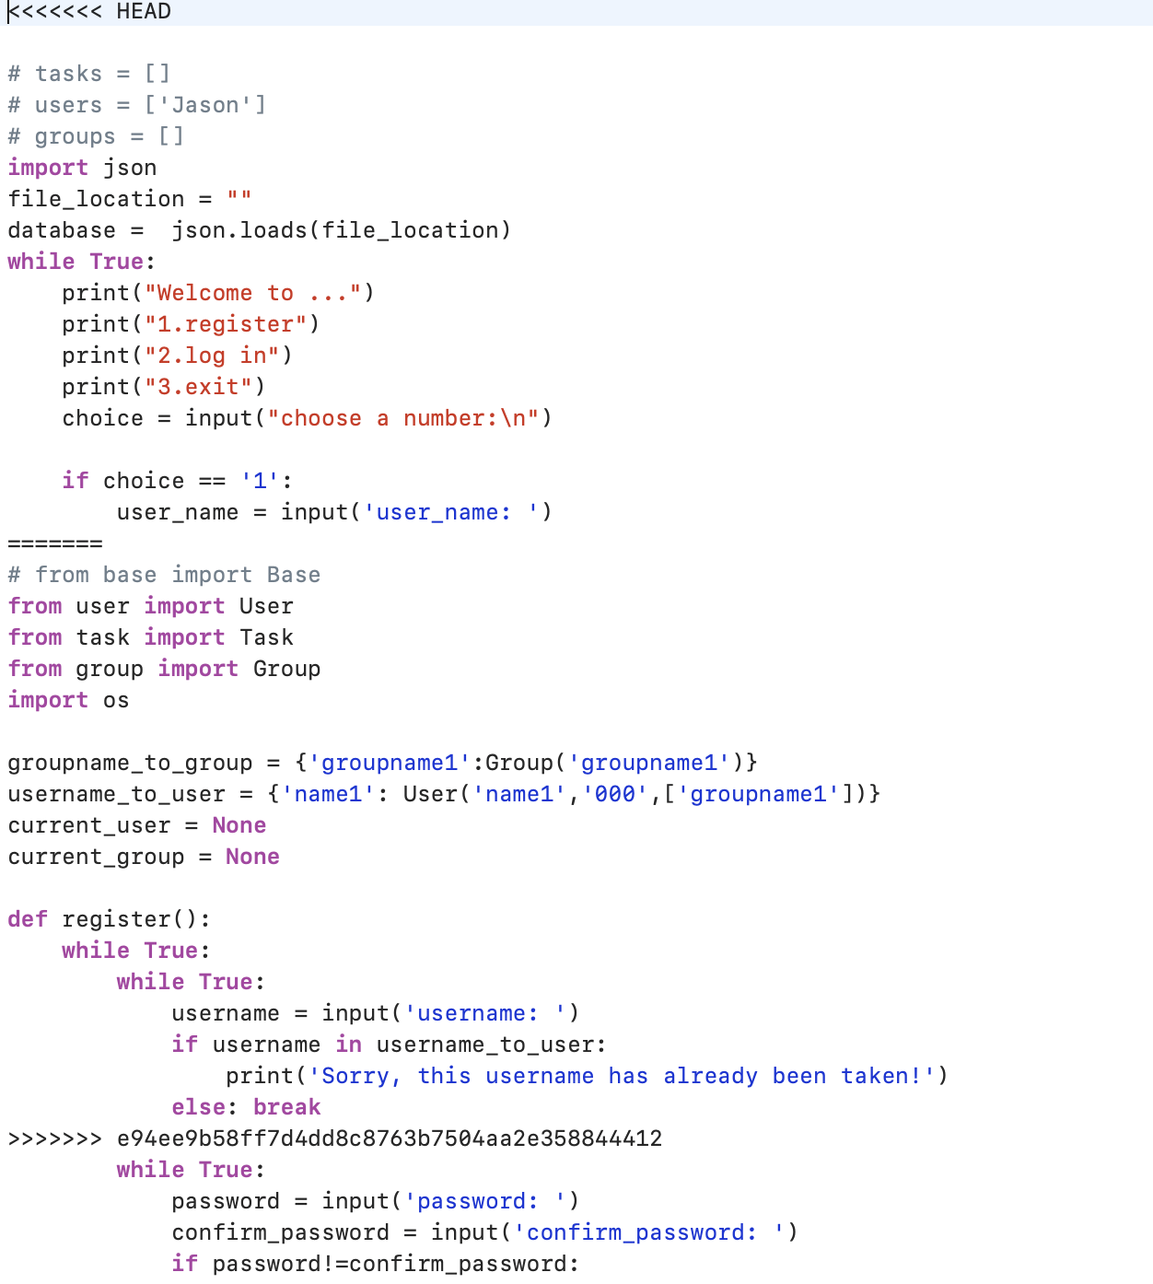
Command function
The command function as implemented below
Test Module
Submodules included

Slide 7
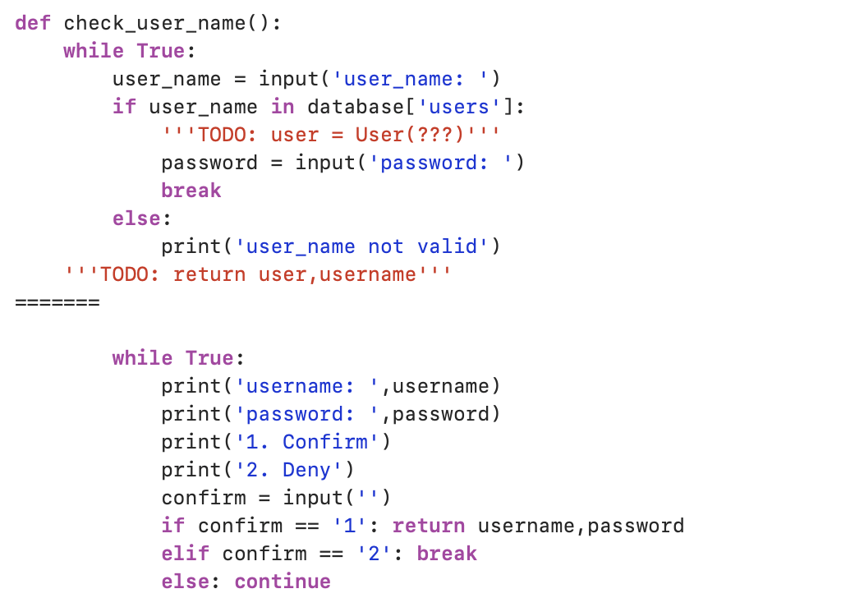
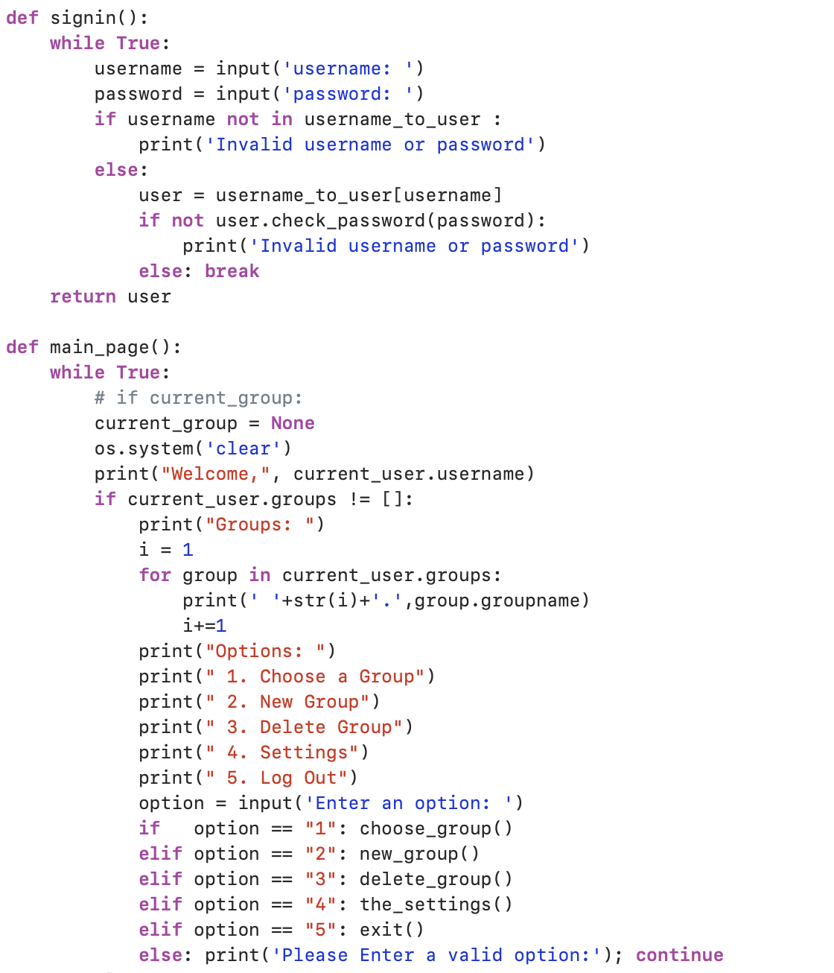
Check if the username is in the system
Signin function
Main page setting

Slide 8
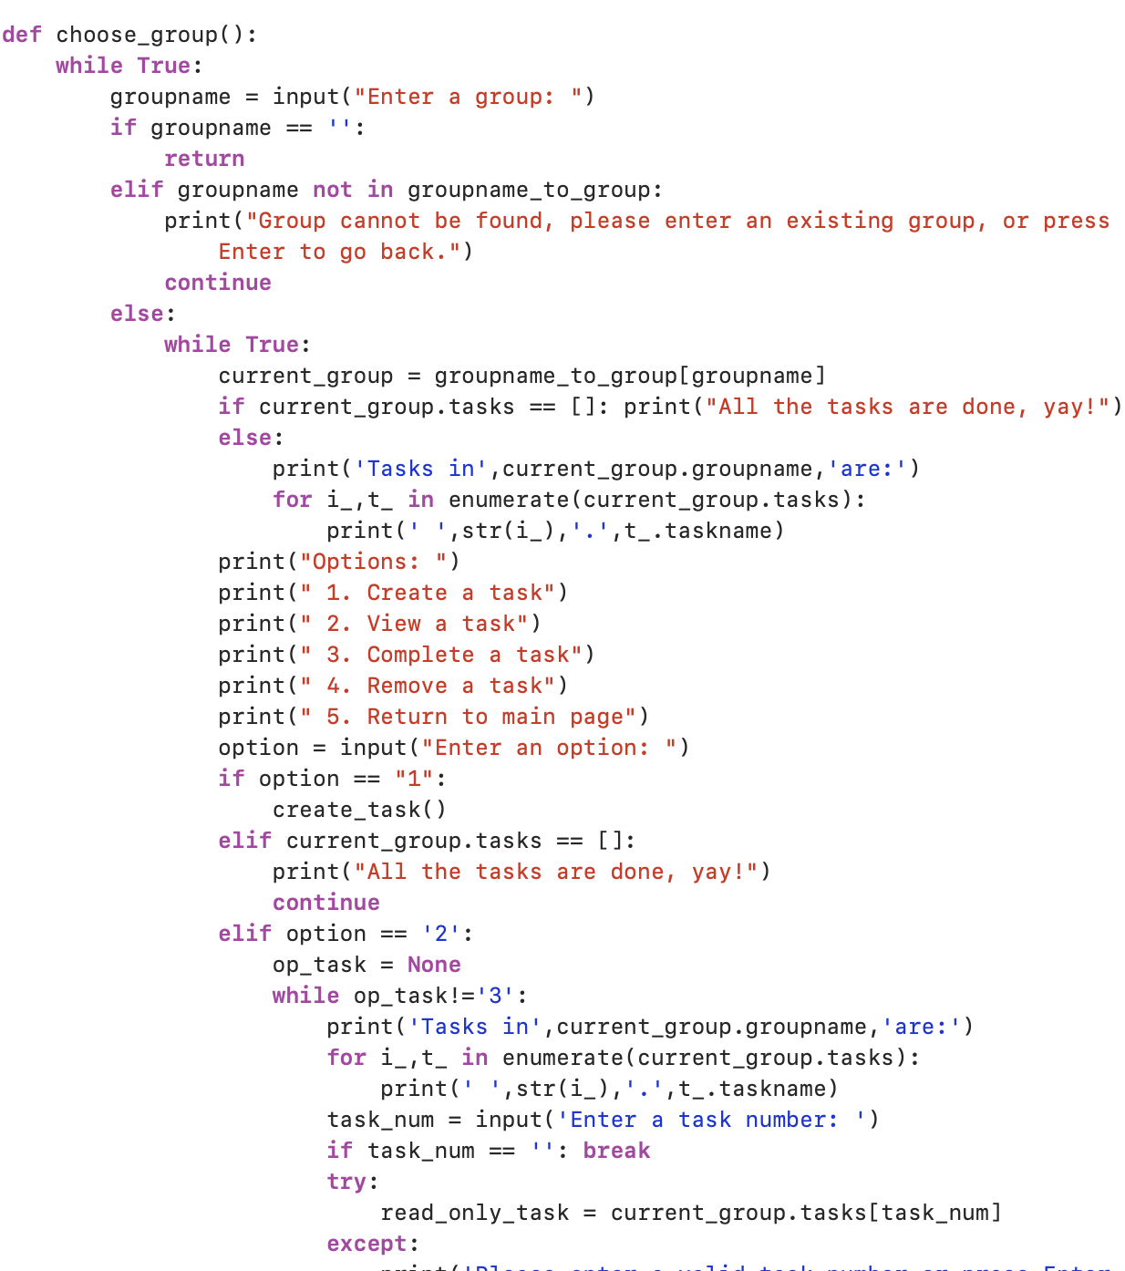
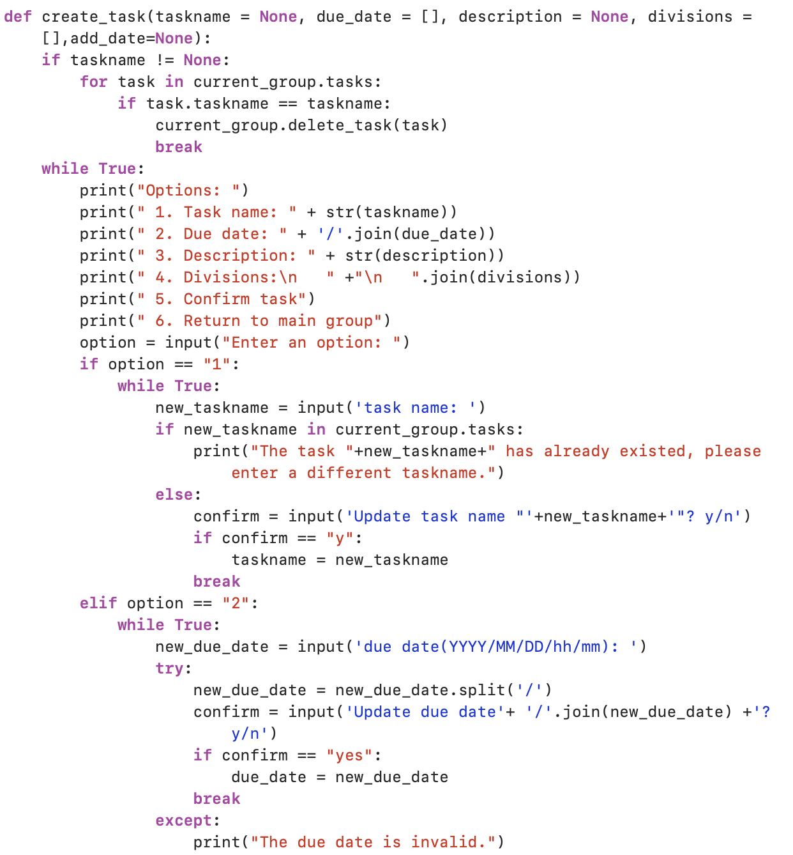
Users can choose group to join
Create a new task

Slide 9
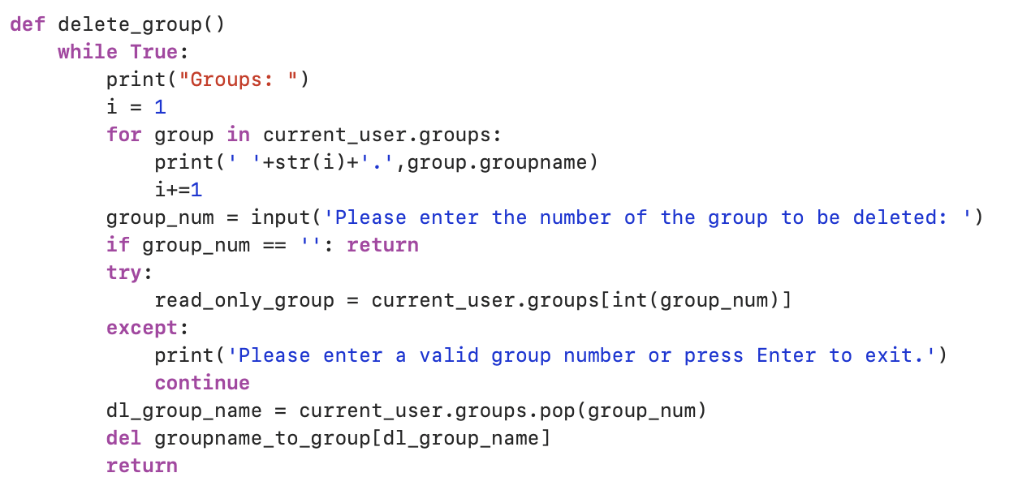
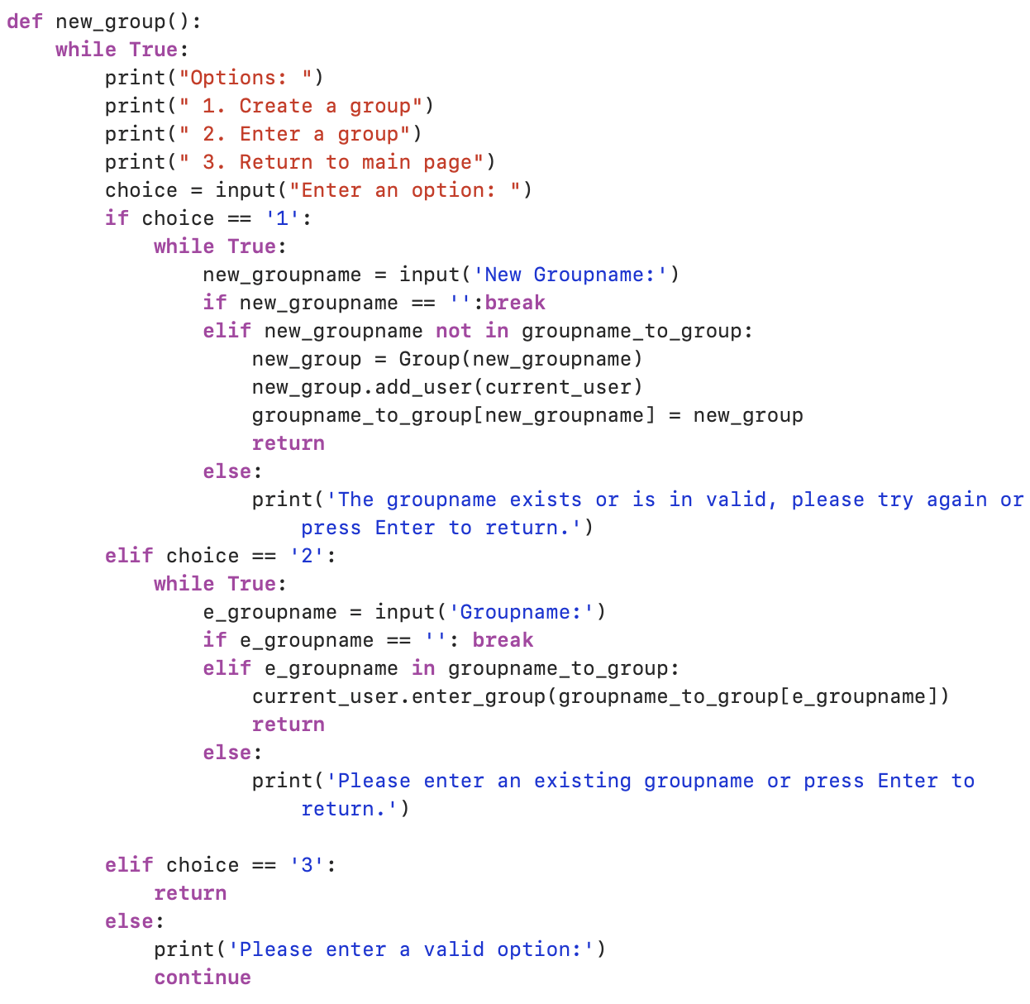
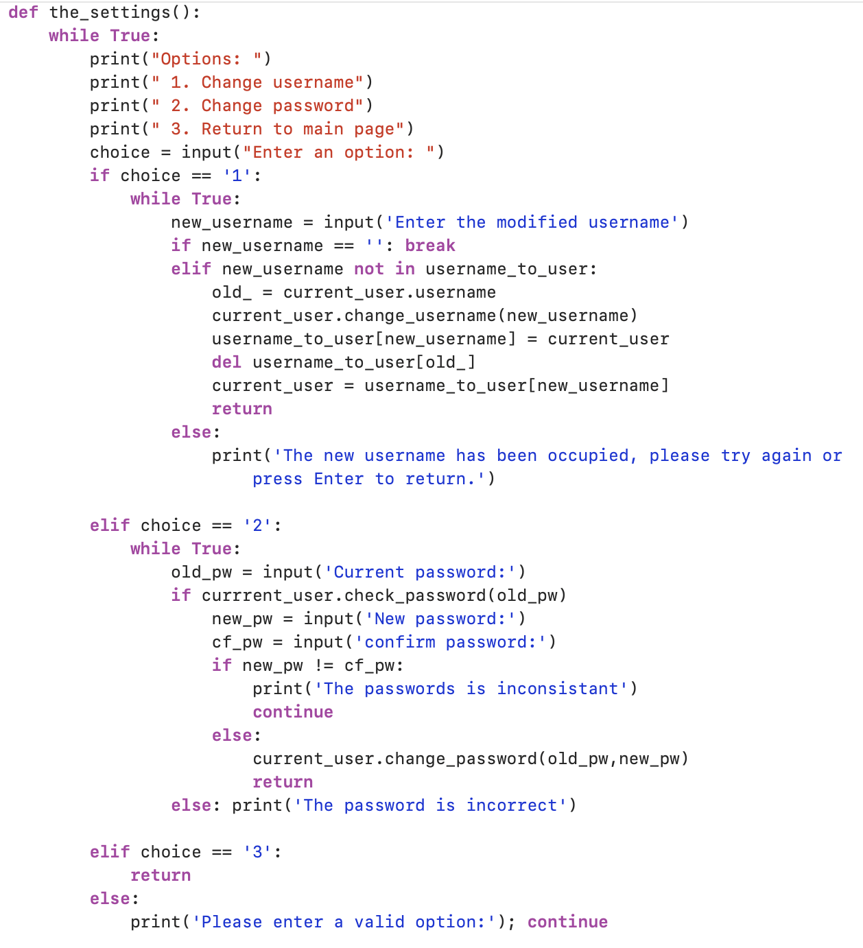
Create a new group
Delete Group
The login page setting

Slide 10
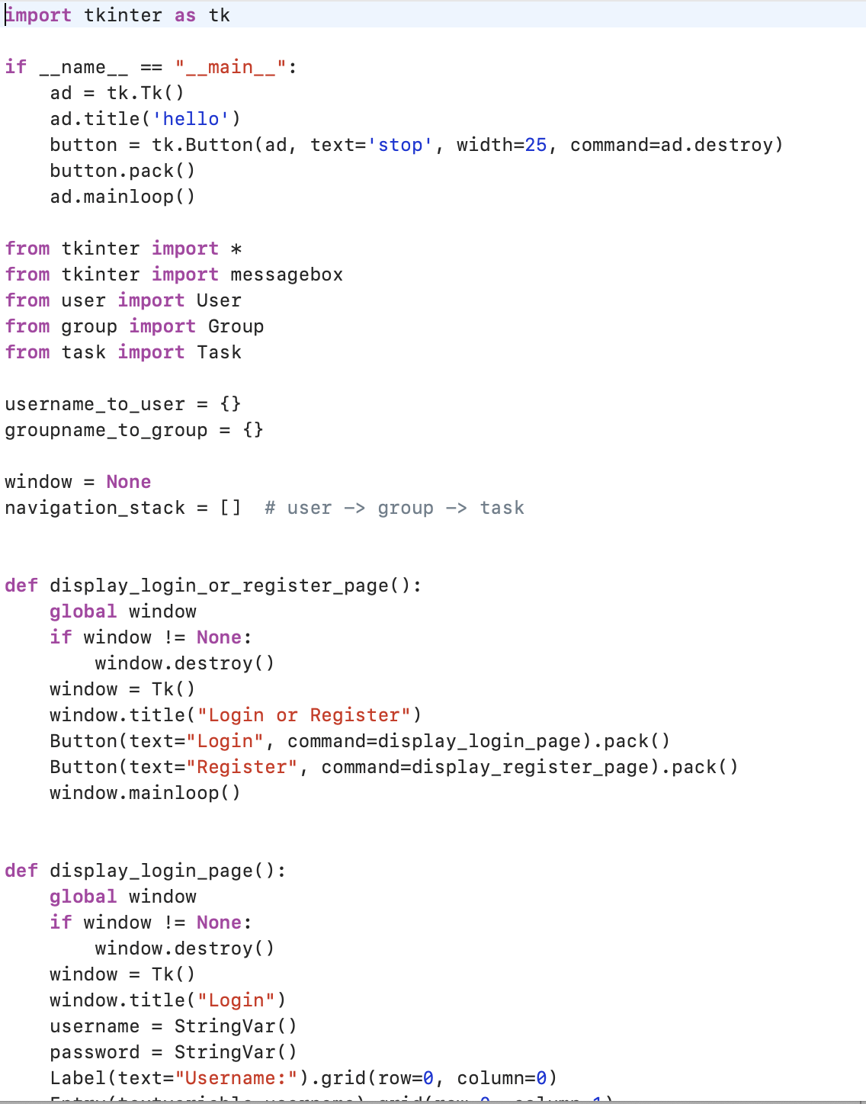
The GUI Function
Another main function implemented as below (Sample).
This function is used for graphic representation.
Import tkinter

Slide 11
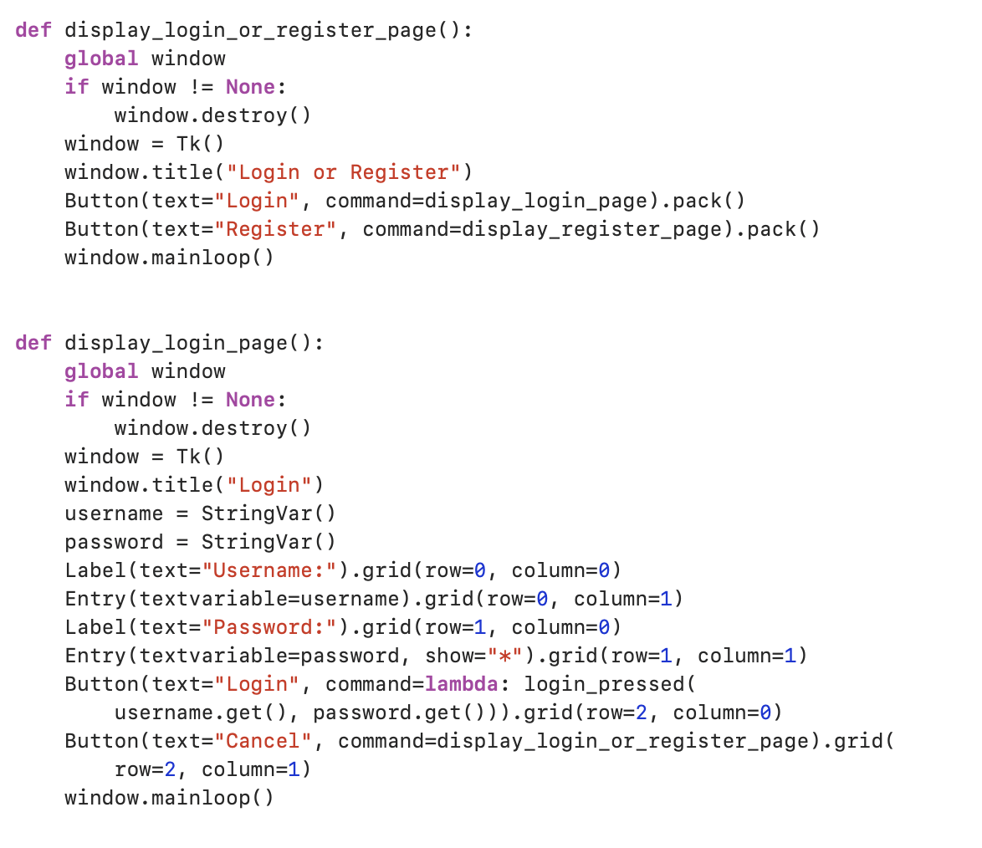
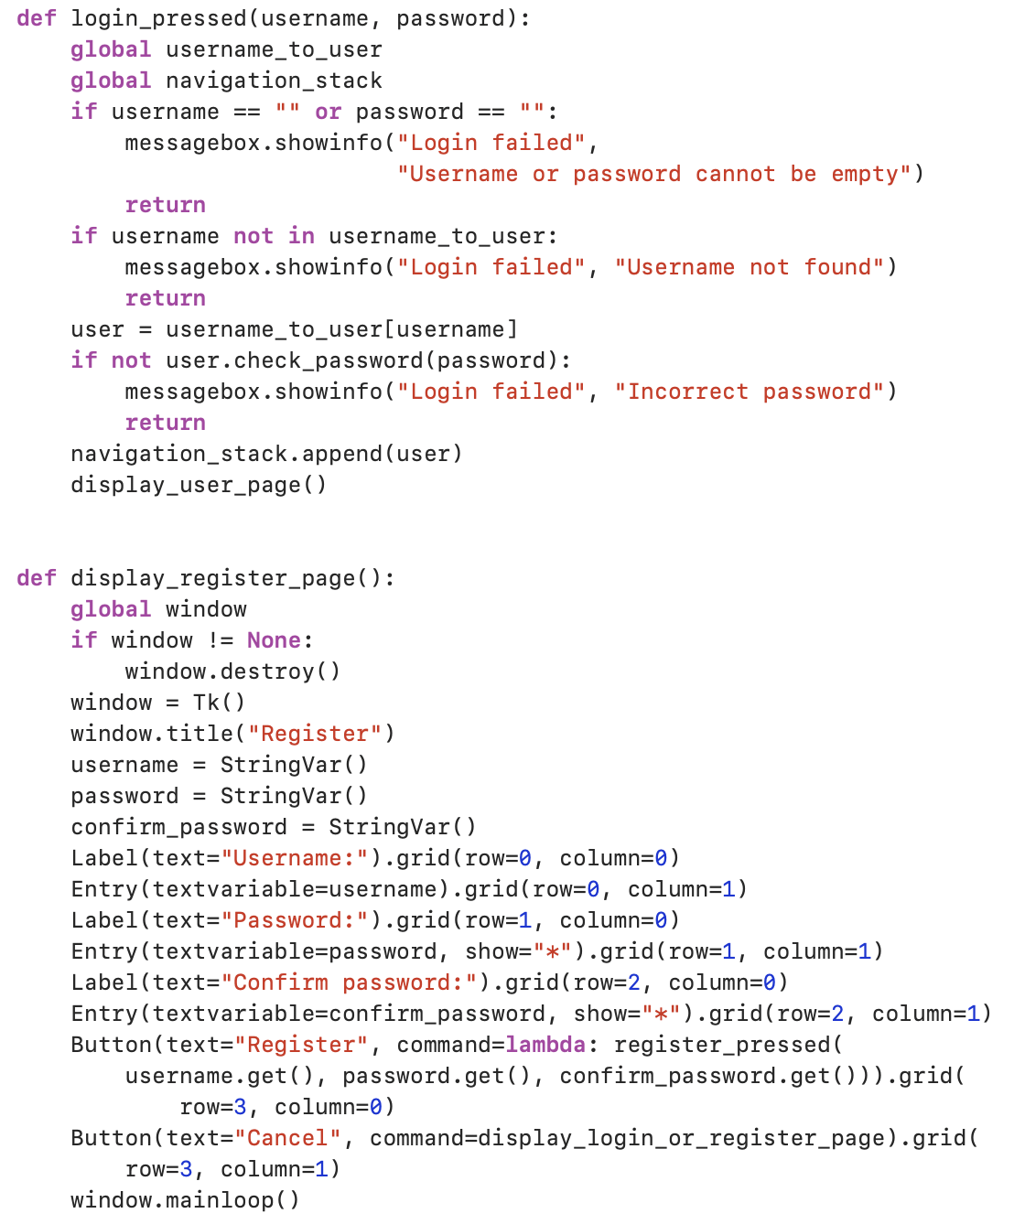
Display of the login page

Slide 12
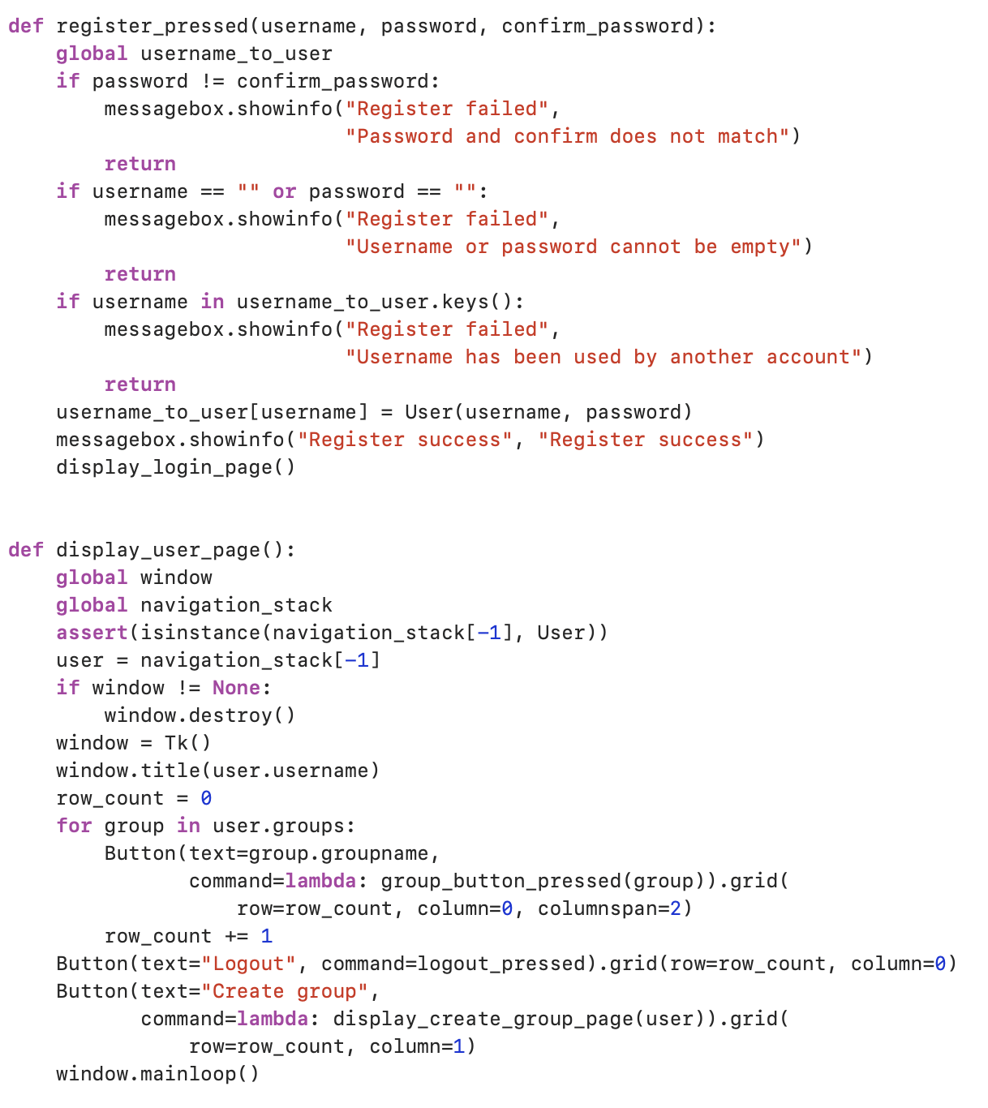
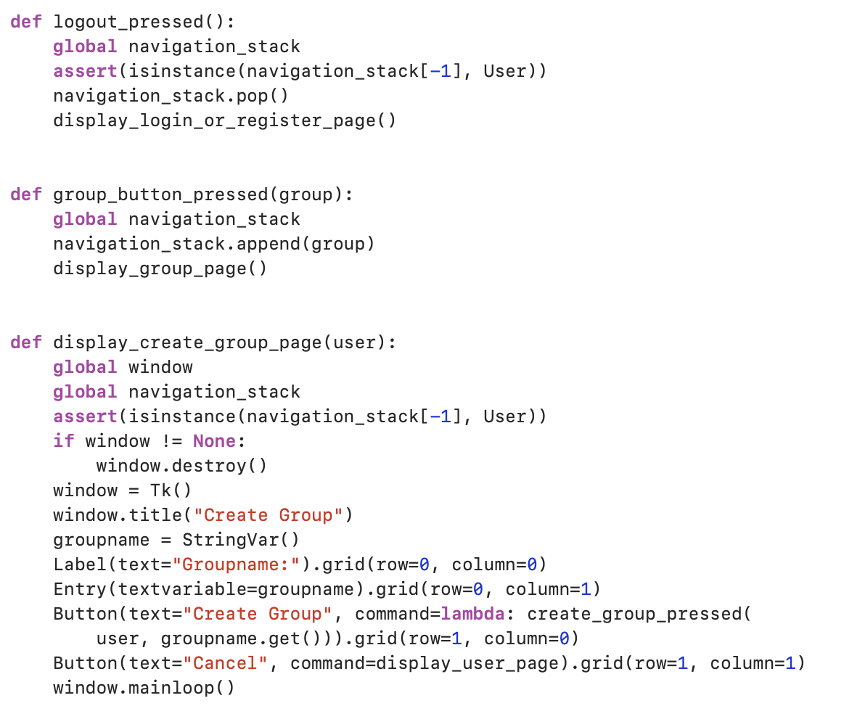
register_password
Logout
Enter the group page
The display of the user page
Display of the group creation page

Slide 13
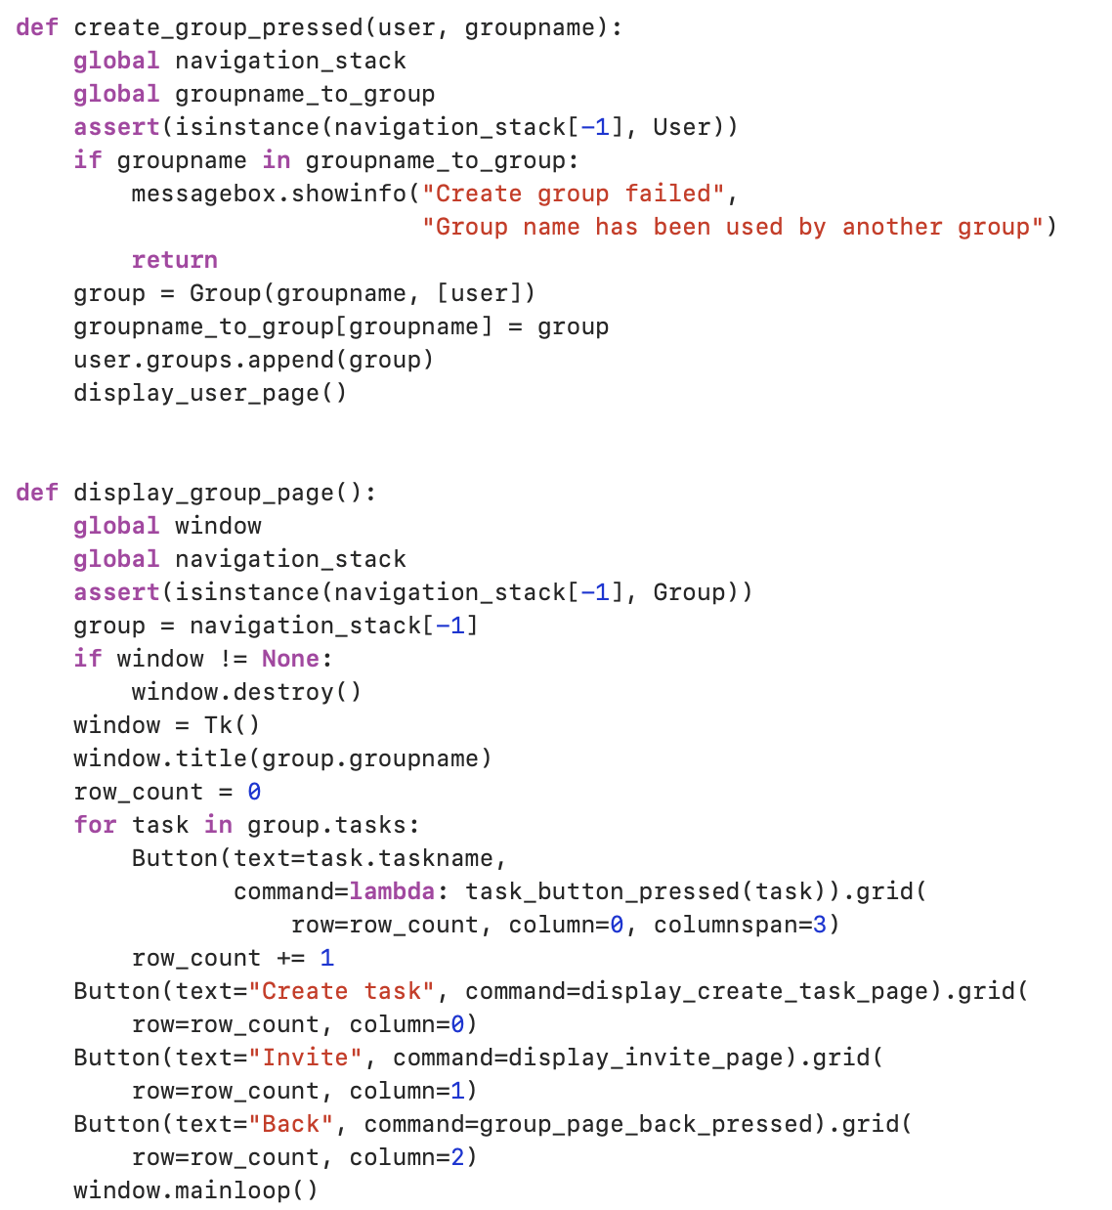
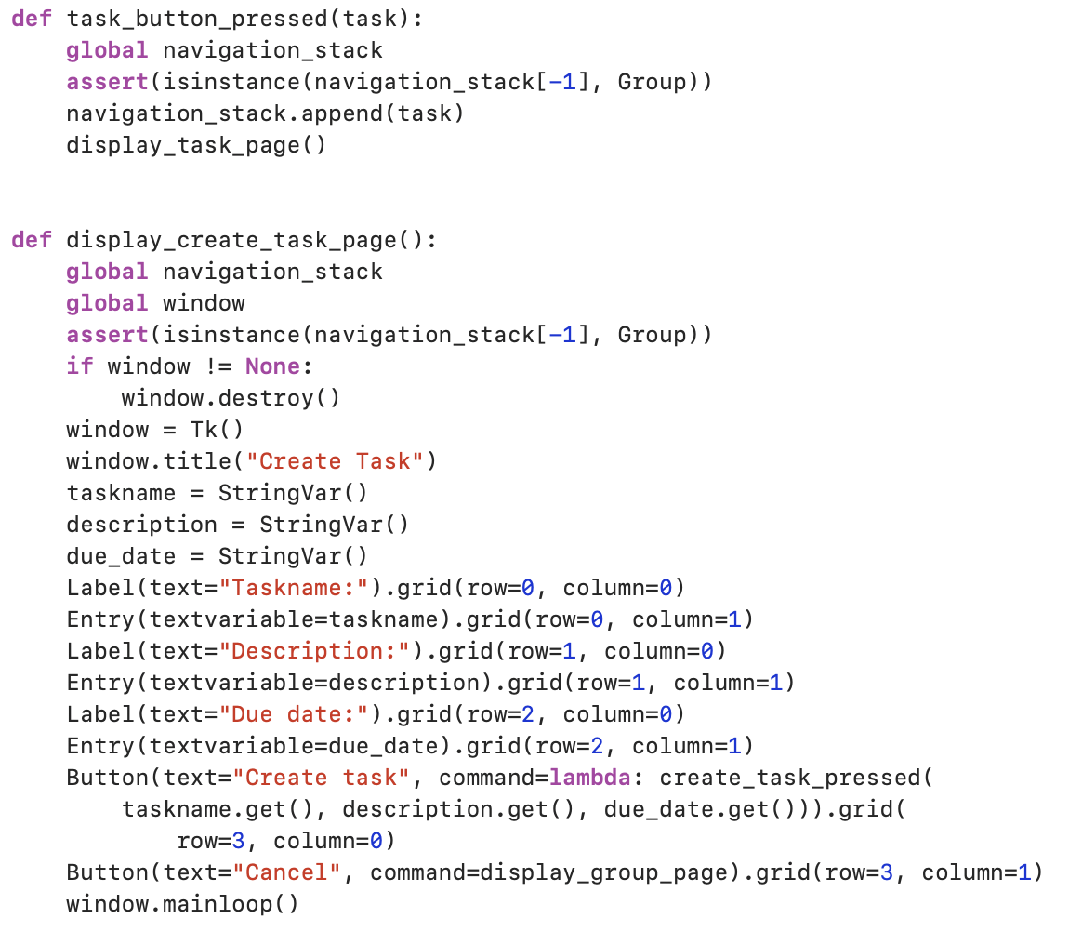
Create group
Create new tasks
The display of the create task page
Display the group page

Slide 14
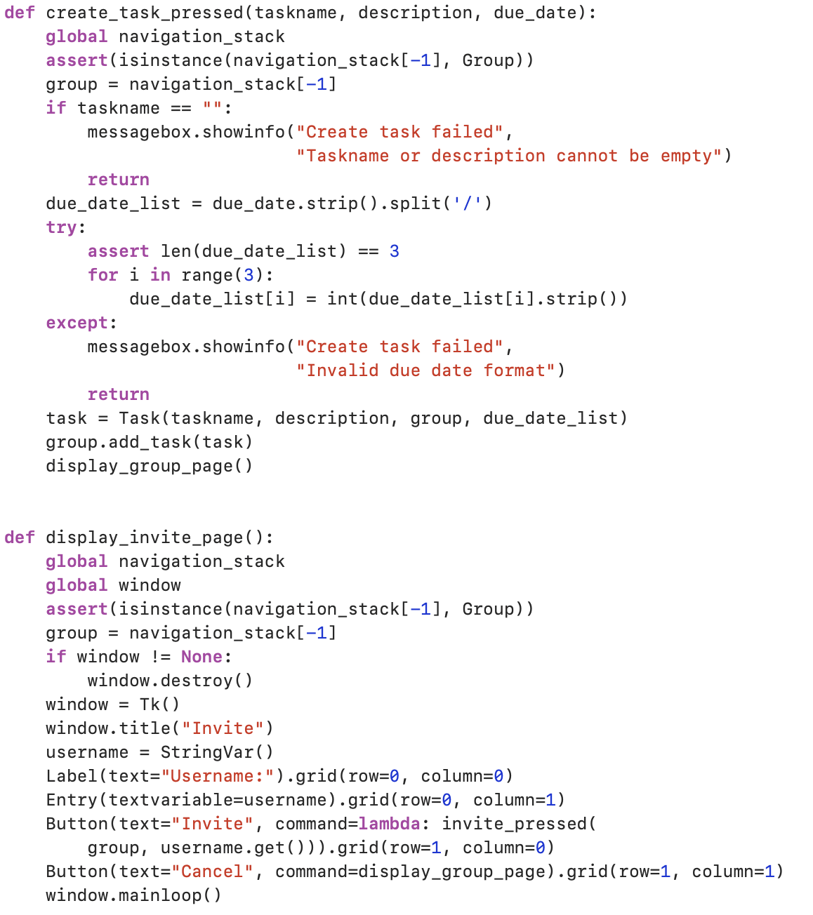
Create task
Display of the group invite page

Slide 15
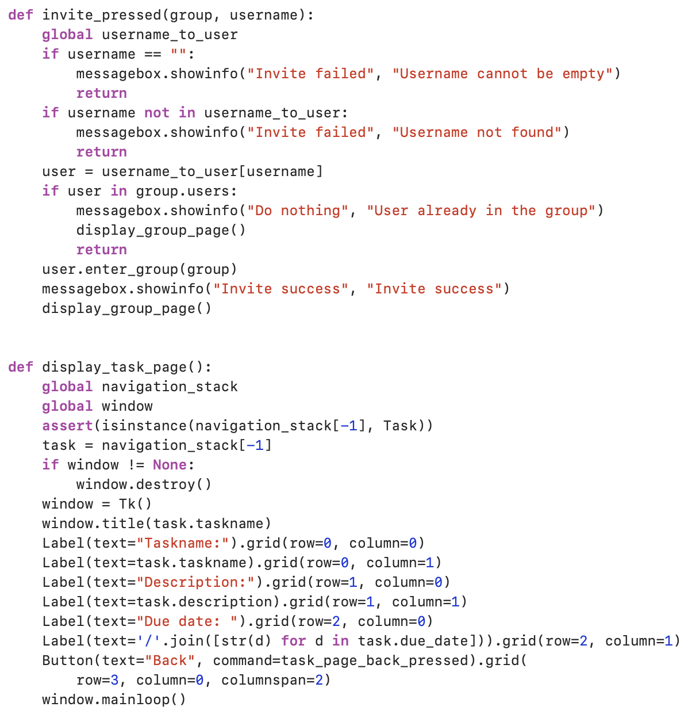
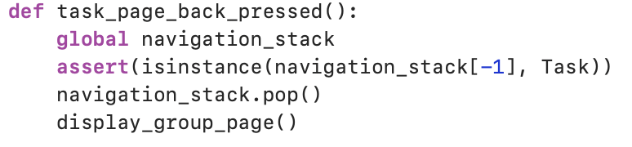
Invite members
Go back to the task page
The display of the task page

